Slide 1
Windows.UI.Composition: The Next gen UI foundation 10586 SDK Update
John Serna and Paul Gildea
@WinComposition

Slide 2
A Brief History of the API

Slide 3
Windows.UI.Composition
Next gen UI foundation
Visual layer positioned below frameworks (XAML, Web) and above D2D/D3D
Creating trees of Visuals with custom Rendering, Effects and Animations
High performance, retained mode, thread agile, async programming model
WinRT API created in Windows 10
Available in Windows 10 Version 1511 using SDK10586 and basic XAML interop
Targeting Universal Windows apps
Notes:
In win10 we created a new unified compositor and rendering engine for all modern applications
Unified Composition WinRT API called Windows.UI.Composition that offers access to new lightweight Composition Objects along with new Compositor driven Animations and Effects
Declarative/retain mode API (unlike D2D which is immediate-mode)
Can be called from any UWP
Use to create composition objects, animations and effects

Slide 4
Overall API Goals
Foundational API for all major UI platforms on Windows
Optimized for highly dynamic, interactive content
Enable gorgeous UI with effects, animations and manipulations not possible today
Designed for incremental interoperability with existing frameworks like XAML.

Slide 5
What is it not?
Not a rasterizer:
Consumes bitmaps / DWrite / D2D / D3D generated content.
Not a high-level framework:
No application model integration (navigation, suspend-resume, etc.)
No complex layout (measure, size, arrange, etc.)
No controls
No scripting / markup
No data binding
No localization
No theming / styling
Notes:
Note: removed point regarding no support for input handling since we are planning to do work in this space in redstone
Comment from Nick: Should we call out XAML content in things it consumes?

Slide 6
Demo: Slide Show

Slide 7
Visual Layer in Windows 8.1
Windows 8.1 / Phone Store Apps
Windows.UI.Xaml
UI Tree, Control Model, Layout, Property System Databinding, Accessibility
Framework Layer
DirectComposition / DirectManipulation
Composition Tree, Primitive Rendering, Animation Execution, Manipulation Threads
Visual
Layer
DirectX Family
2D and 3D drawing, Meshes, Shaders, high degree of control over presentation
Graphics Layer

Slide 8
Visual Layer in Windows 10
Universal Windows Application
Easy
Windows.UI.Xaml
Framework Layer
Controls, layout, markup, accessibility, data binding
Windows.UI.Composition
Visual
Layer
Visuals, Animations & Expressions, Effects, Input Routing & Manipulations
DirectX Family
Text rasterization, shapes & vector rasterization
ink rendering
Graphics Layer
Possible
Notes:
XAML developer can “drop down” to the composition layer in C# to do custom work in the composition layer sing WinRT to create a “Composition Island” of objects in their XAML application rather than using DX s

Slide 9
What’s in the Visual layer today?
Content Visuals
Family of lightweight rendering objects.
Effects system
Real-time effects system whose effects can be customized, animated and chained.
Animation system
Expressive, framework-agnostic animations run independent of the UI thread.
SpriteVisual
Solid color content
Image content
D2D/D3D content
CompositionDrawingImage
AnchorPoint
Backface visibility
Basic XAML interop
Color effects
Contrast
Exposure
Grayscale
Gamma Transfer
Hue Rotate
Keyframe animations
Expression animations
Expression operators like sin, cos, etc.
Property Swizzling and Masking
Color Animations
Quarternions
CompositionBatch
Invert
Sepia
Temperature
Tint
2D Transforms
Blend and Composite Effects

Slide 10
Content Visuals
Family of lightweight rendering objects

Slide 11
Visual object and class hierarchy
Target
CompositionObject
Properties:
Statically set or
Bound to animations
Basic positioning
Setting offsets relative to parent or window.
Clipping
“Inset” from size of object
Transforms
2D and 3D transformations to alter the size, position or nature of a visual.
Build Tree:
Establish parent-child relationships
Display Rasterized Content (Brushes)
Composes and renders serialized drawing content.
Visual
Visual
Visual
Visual
ContainerVisual
Brush
Brush
SpriteVisual
Windows Composition Visual Tree
Composition Visuals
Hierarchy
Notes:
Composition objects are created by the Compositor which acts as a factory for composition objects.
Compositor can create Visual objects each representing a single node in Visual tree
Visuals can be containers for other visual or can host content Visuals
VISUAL TYPES + BASE BRUSH CLASS
Visual – The base object (that has majority of properties) and inherited by other visual objects
ContainerVisual – derives from visual and adds ability to insert child visuals
SpriteVisual –
derives from CV and Contains content in form of images, effects and swapchains
Adds ability to associate a brush so that the Visual can render pixels including images/effects/solidcolor
CompositionBrush
Allows the application of an effect on the content of a visual. Has number of subclasses

Slide 12
Demo: CompositionVisual

Slide 13
Effects
Real-time effects system whose effects can be customized, animated and chained
Notes:
https://osgwiki.com/wiki/Composition_Team/WinRT_Effects
Windows.UI.Composition effect system is a new API that allows applying visual effects to composition visuals
Shares effect description with DirectImage, Win2D and MediaFoundation
Be a building block for XAML to expose high-performance effects
Windows.UI.Composition supports real time effects that can be animated, customized and chained.

Slide 14
Effects
New, real-time Effects system whose effects are applied as a content on a visual.
Rich UI: Blend and Composite modes.
Animated: Effect properties (like saturation amount) are animatable
Flexibility: Effects can be Customized and chained
Consistency: Same effect descriptions used for composition, graphics, video (future)
High Perf: Selected effects in order to ensure highly responsive 60FPS scenarios at scale
Notes:
Note: talk about single pass shaders for high perf

Slide 15
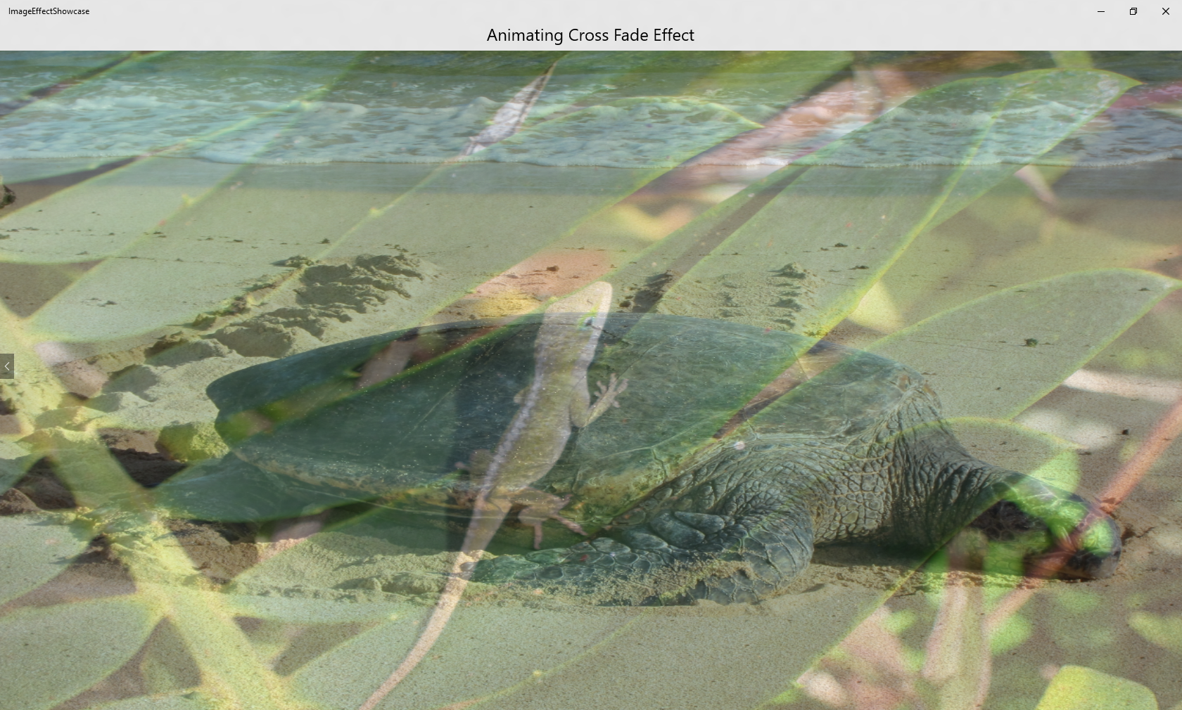



Supported Effects in TH2
ArithmeticComposite
Blend
(21 different modes)
Saturation
And:
2D Affine Transform, contrast, exposure, grayscale, gamma transfer, hue rotate, invert, sepia, and temperature and tint
Composite
(13 different modes)
Notes:
Can talk about more filters and effects

Slide 16
Demo: Effects

Slide 17
Animation System
Expressive, framework-agnostic animations run independent of the UI thread
Notes:
Windows.UI.Composition contains an expressive, framework agnostic animation system that allows you to set up two types of Animations: key frame animations and expression animations.
These are used to move visual objects, drive a transform or a clip, or animate an effect.
By running directly in the compositor process, this ensures smoothness and scale, letting you run large numbers of concurrent, unique animations.

Slide 18
Keyframe animations
Animations as a function of time defined as a sequence of key frames
Control acceleration using easing functions: Linear, Cubic Bezier
Support for various property types: Scalar, Vector2/3/4, Quaternion
Smooth at scale and optimized for performance at 100s of animations

Slide 19
Expression animations
Animations are a mathematical relationships that describe value of animation property at each frame.
Easily create complex user experiences: Sticky headers, Parallax, Scrolling indicators…
Easily re-use defined animations
Built-in functions: Abs, Clamp, Max, Min, Mod, Scale, Transform, Vector*, Matrix*
Swizzling/Masking support
Smooth at scale and optimized for performance at 100s of animations.
Notes:
Note : Expression animations are simply a mathematical relationship to describe the value of an animation property at each frame, and although there are technically a function of time, they never end.
Note: swizzling/masking support. This enables things like individual animations of channels of a property (for example if you want to animate color and control the timing of the RGB/HSB channels separately – which animators do want to do).

Slide 20
Demo: Parallax

Slide 21
XAML + Windows.UI.Composition
Notes:
In addition to creating a visual tree from scratch, the Composition API can interoperate with an existing XAML UI.

Slide 22
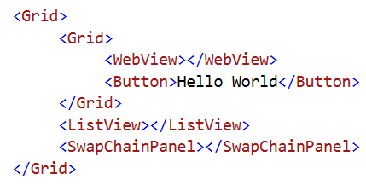
XAML and Composition
Visual: how do composition and XAML content compose together seamlessly
< />
Visual
Visual
< />
< />
< />
Visual
Visual
Visual
Visual
WebView
< />
< />
Visual Layer
Framework Element Layer
SwapChainPanel
Button
Notes:
Why use Comp in XAML
Drop down to realize more complex animations and effects with very little code
Scale: need to animate a lot of different elements simultaneously
Input-driven animations: like Sticky Headers, Parallax
Lower level toolkit for building richer custom controls

Slide 23
XAML + Composition– Just the basics
Basic interop support for Visuals
ElementCompositionPreview.GetElementVisual()
ElementCompositionPreview.GetElementChildVisual()
ElementCompositionPreview.SetElementChildVisual()
ElementCompositionPreview.GetScrollViewerManipulationPropertySet()
Make XAML hit-testing Composition aware
XAML updates its UIElement’s state to account for the backing handoff visual actual position
Notes:
The ElementCompositionPreview class in Windows.UI.Xaml.Hosting allows access to the ContainerVisual object backing a XAML element with the GetContainerVisual method
Once the backing object has been retrieved it can be manipulated using the Windows.UI.Composition namespace
This allows properties of the object to be changed, like the orientation, or additional objects to be added to the XAML composition tree.
ManipulationPropertySet() – Allows a developer to access the manipulation transform of XAML controls backed by DManip( e.g. Scrollviewer and ListView) and use that PropertySet to drive expressions

Slide 24
Demo: Interop – Parallax Redux

Slide 25
More Info:
Product docs: https://msdn.microsoft.com/en-us/library/windows/apps/windows.ui.composition.aspx
Overview/Concept Docs: https://msdn.microsoft.com/en-us/library/windows/apps/xaml/mt592880.aspx
Github: https://github.com/Microsoft/composition
Samples: https://github.com/Microsoft/composition/tree/master/SDK10586_NOV_UPDATE_RTM
Twitter:
@WinComposition

